Slide 1
Promoting Sustainable Transportation
Notes:
Created from: https://chatgpt.com/share/6710e69c-5618-8001-a7e3-f57ee5116e1c

Slide 2
What is Sustainable Transportation?
Systems that are eco-friendly, accessible, and efficient
Reduces carbon emissions and reliance on fossil fuels
Promotes healthier commuting alternatives
What types of transportation do you think qualify as sustainable?

Slide 3
The Urgency for Change
Cities becoming congested with vehicles
Rising air pollution and greenhouse gas emissions
Accelerating climate change
Sustainable transportation can help combat these issues
How have you noticed transportation impacting your local environment?

Slide 4
Benefits of Sustainable Transportation
Improves air quality
Reduces noise pollution
Conserves energy
Promotes physical health
Reduces traffic congestion and carbon emissions
Which of these benefits do you think is most important for your community?

Slide 5
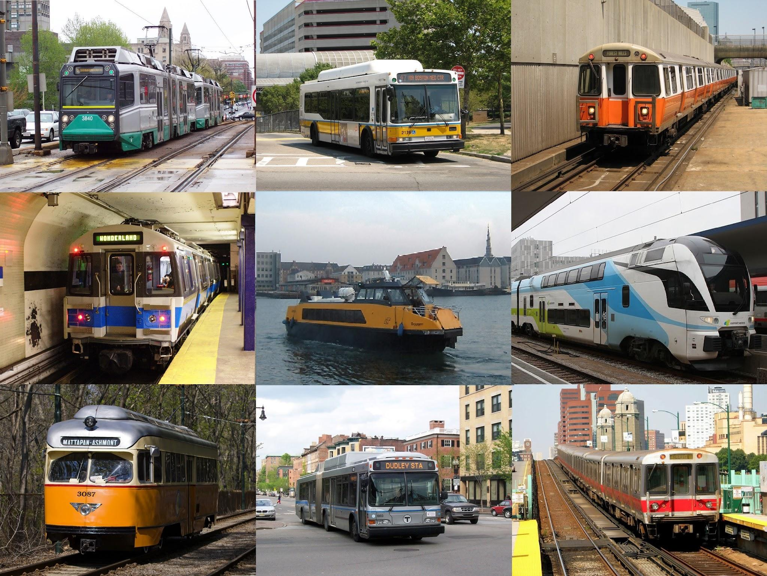
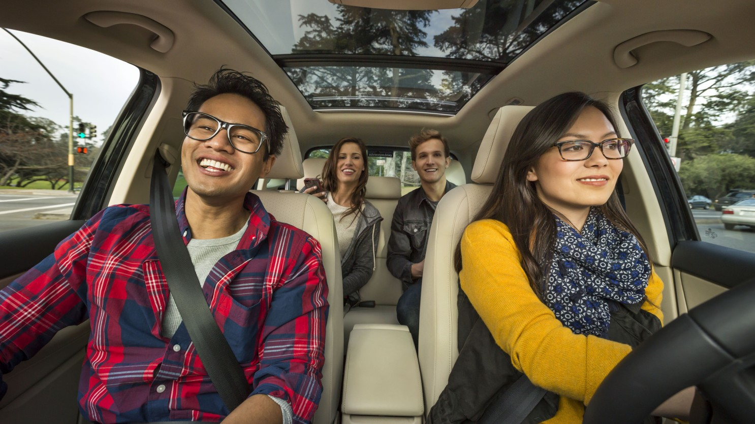
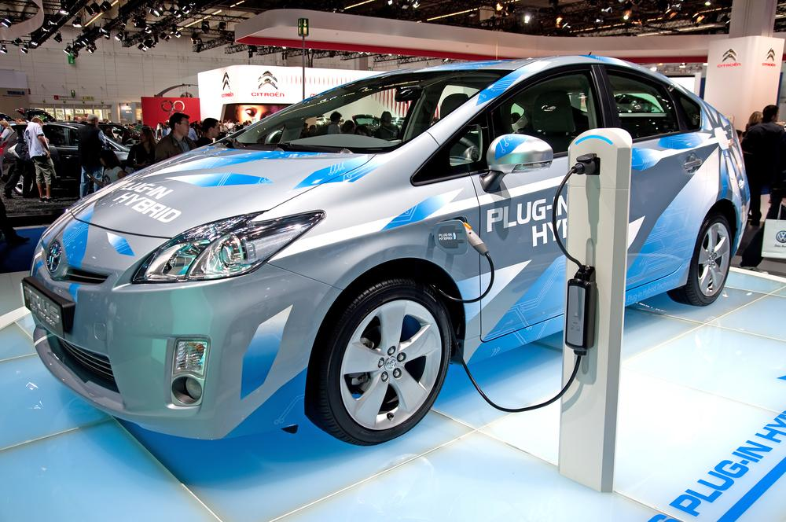
Key Sustainable Transport Solutions
Public transportation
Carpooling
Cycling
Walking
Electric vehicles (EVs)

Slide 6
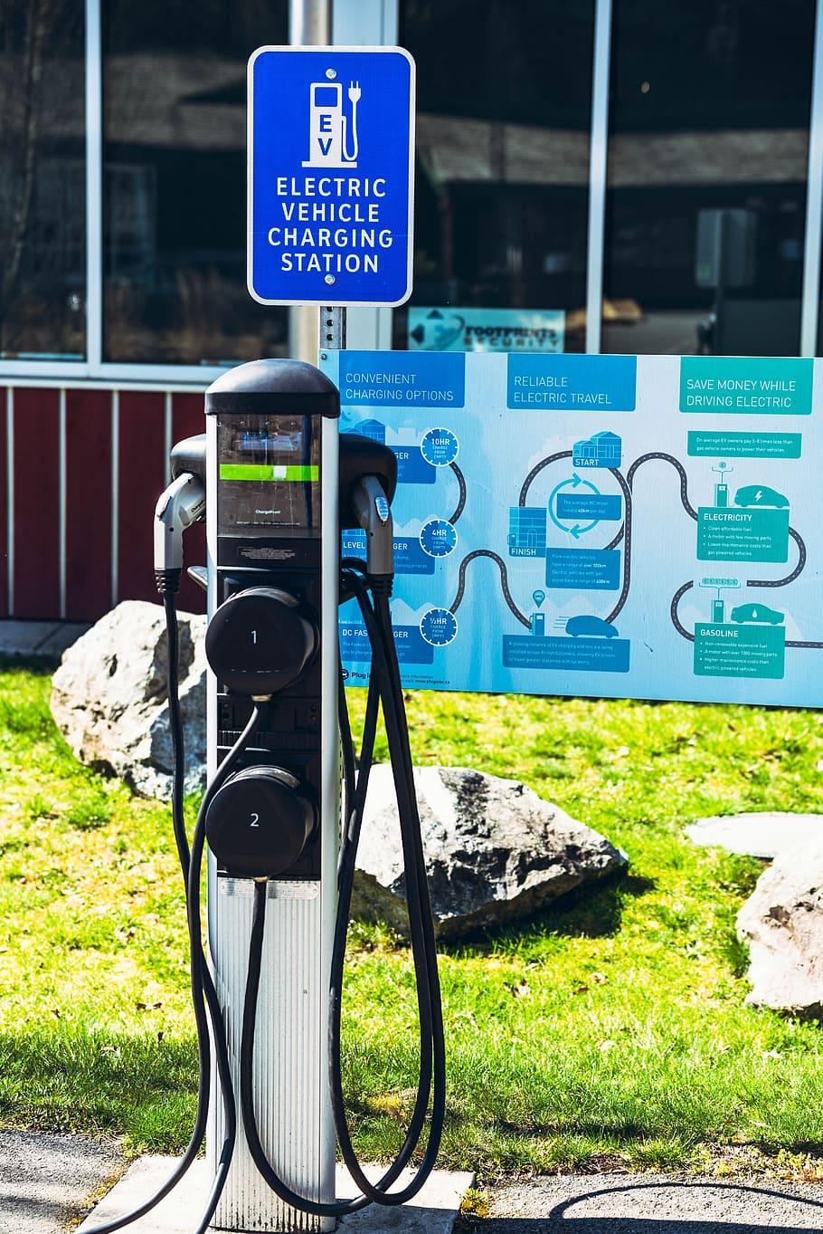
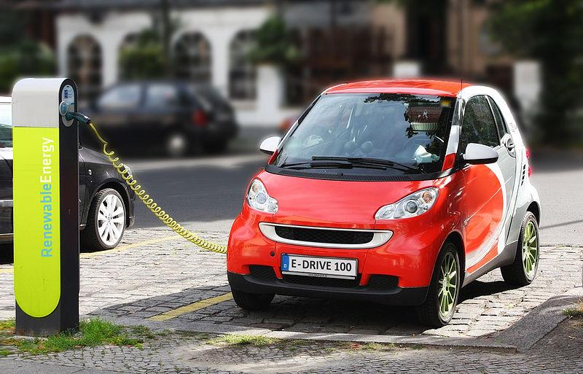
Electric Vehicles and Charging Infrastructure
EVs offer a cleaner alternative to fossil-fuel cars
Expanding EV charging infrastructure
Incentivizing EV use
What challenges do you think people face when considering buying an EV?

Slide 7
Government Initiatives and Policies
Infrastructure investment
Incentives for EVs
Car-free zones
Congestion pricing to discourage excessive car use
What policies do you think would be most effective in your area?

Slide 8
Community Involvement and Advocacy
Advocating for better bike lanes
Organizing carpool programs
Creating initiatives to promote public transportation
Encouraging sustainable travel
How could you get involved in promoting sustainable transportation in your community?

Slide 9
Group Assignment Setup
Split into 3 groups:
Public Transportation | Carpooling | Cycling/Walking
Review your assigned topic
Create a task for another group based on your topic
Complete a task created by another group
Discuss results and share insights as a class

Slide 10
Reflection and Review
Complete a short reflection paper
Think about what you learned during the class
Consider how sustainable transportation solutions apply to your daily life
Explore potential impacts on your community
How might you incorporate sustainable transportation practices into your routine?

Slide 11
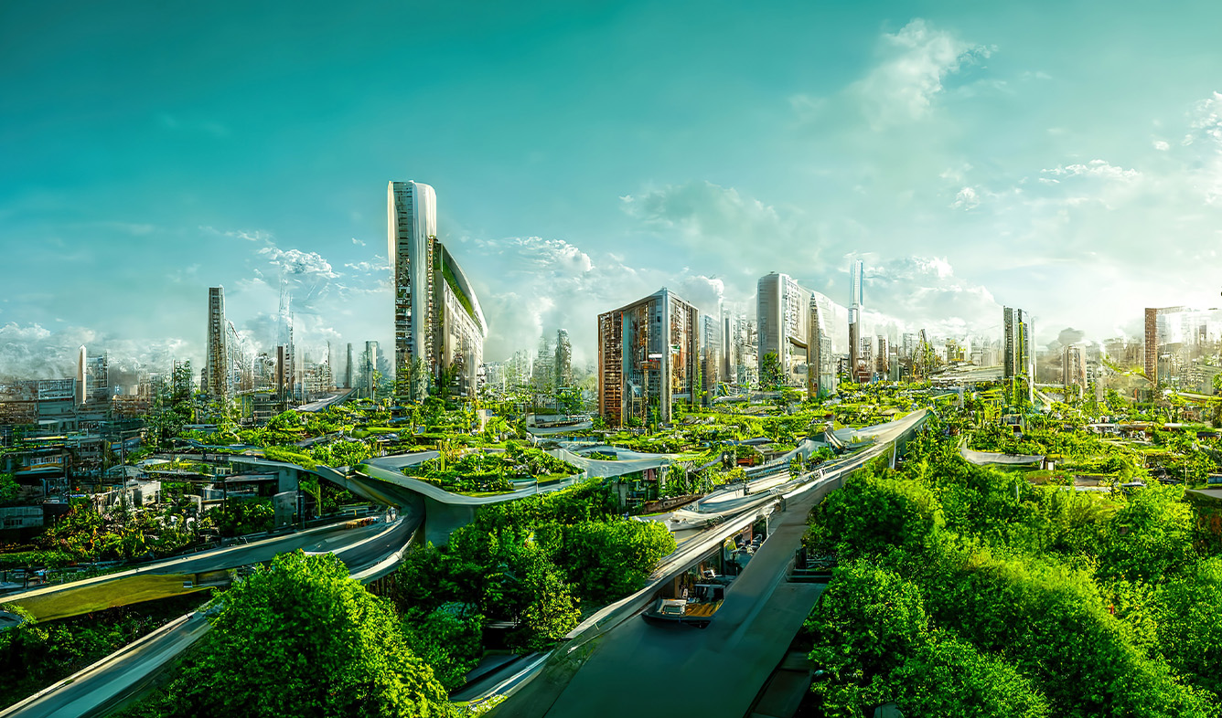
Your Role in Creating a Greener Future
Every choice matters in promoting sustainable transportation
Small changes can lead to big impacts
Be an advocate for greener transportation options
Help create a more sustainable future for all

